Slide 1
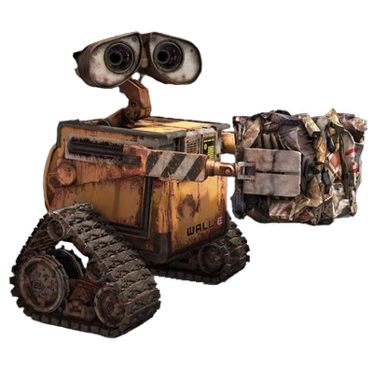

Recycling Waste POSE Detection for Robotic Applications
Gian Moreira, Puru Arora
Simon Fraser University
School of Computing Science

Slide 2

Problem Statement
POSE Detection for Rigid Garbage Objects
Essential for Robotic Movement planning
Tough challenge as there is no direct method to find POSE of objects
Problems with Current Techniques
Use heuristic techniques like FAST-BRISK
Need RGBD Cameras, which are expensive

Slide 3

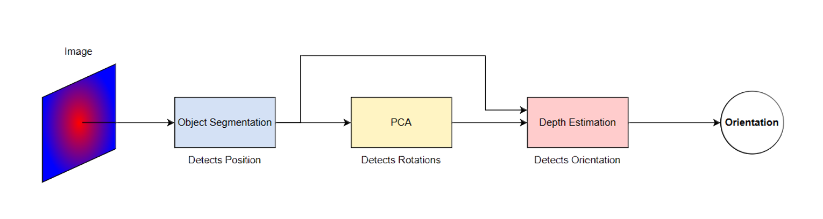
Plan of Action
1 Detect the type of object and segment it to get its xy-position
2 Using PCA, we get the Objects orientation in the xy-plane
3 Collect the extremities of the object along its eigenvectors
4 Use Monocular depth estimation to get the depth field
5 Estimate the objects orientation based on the depth of the points collected at step 3

Slide 4

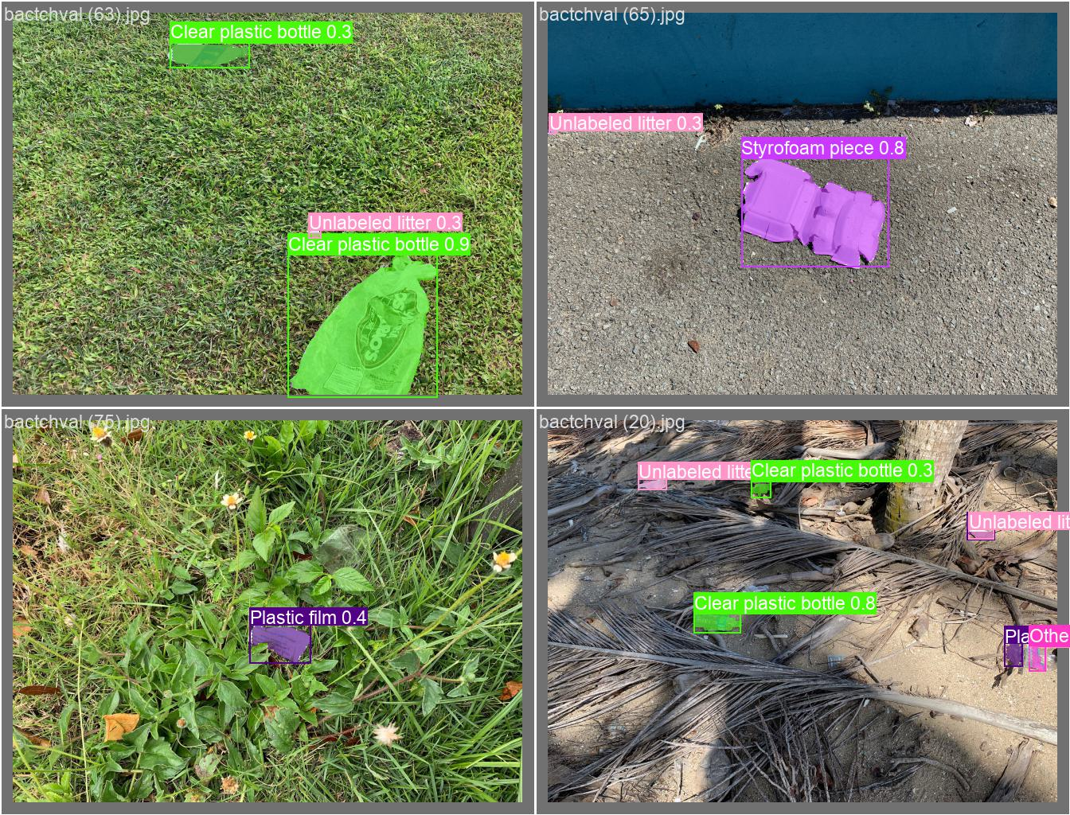
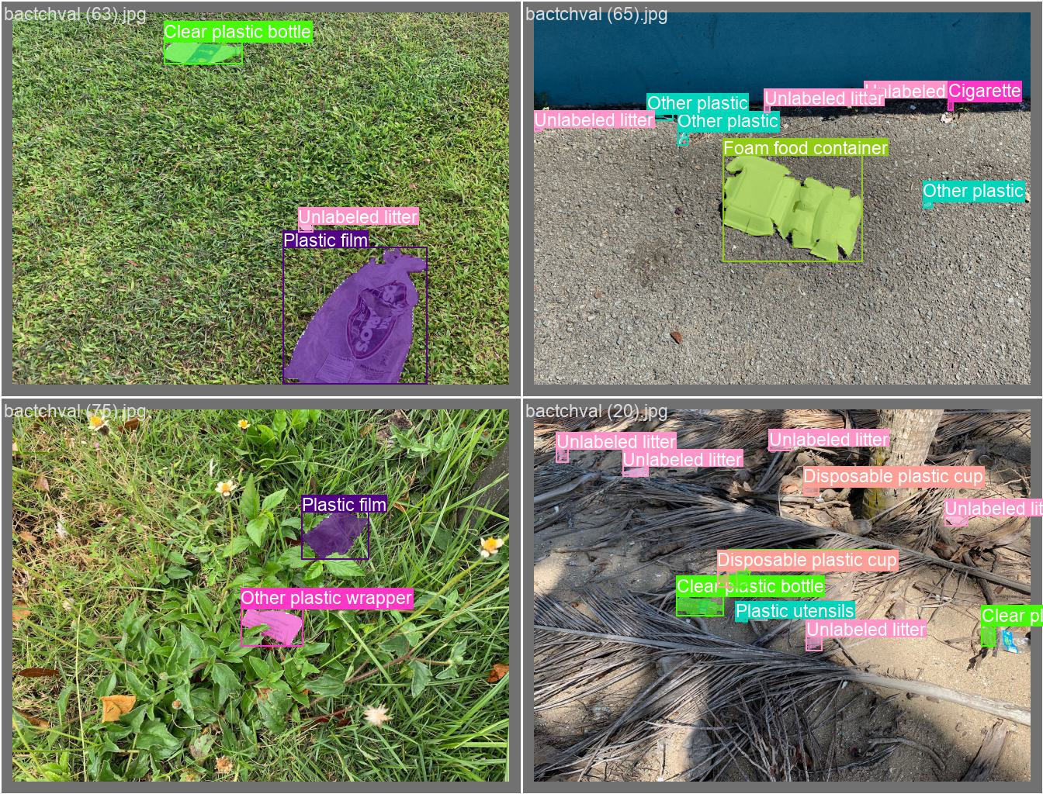

Slide 5

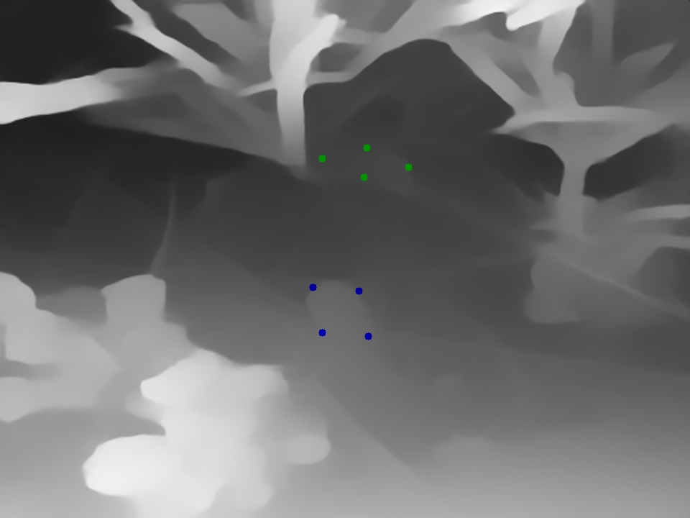
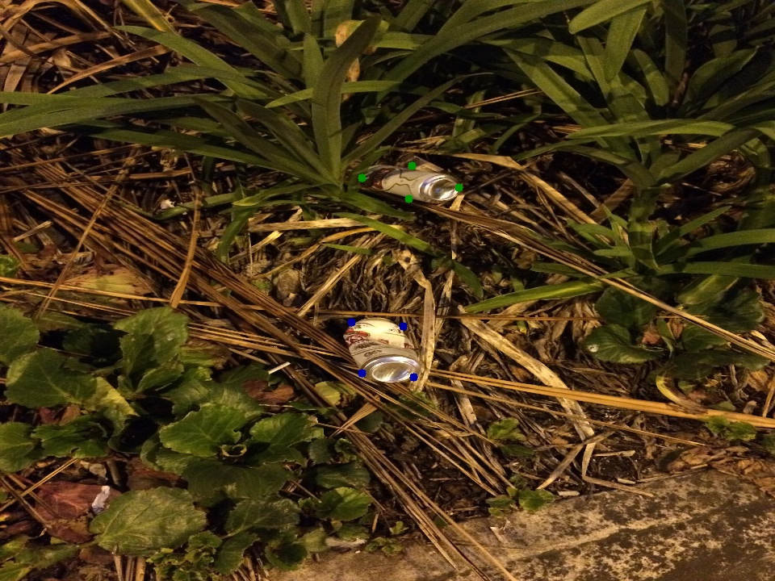
depth x-axis y-axis
b 0.630 0.421 0.693
b 0.682 0.481 0.622
b 0.656 0.421 0.604
b 0.668 0.481 0.711
g 0.587 0.257 0.703
g 0.582 0.213 0.709
g 0.595 0.257 0.790
g 0.583 0.213 0.623
Waste

Slide 6
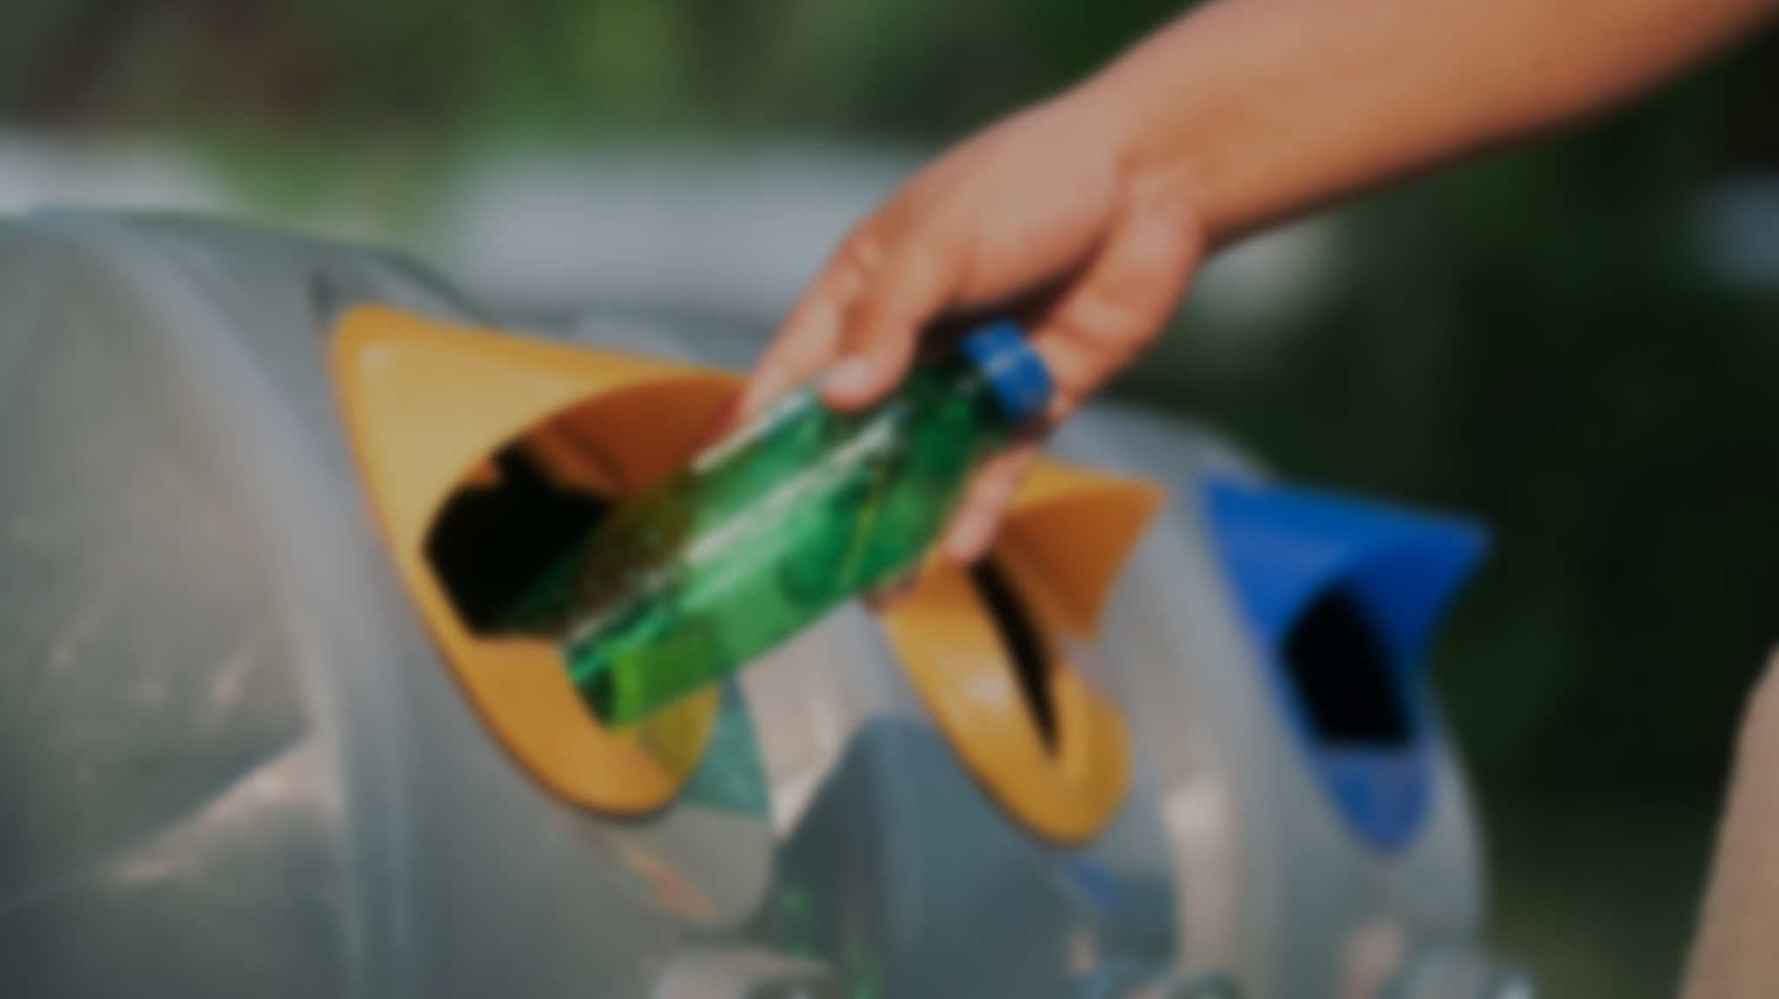
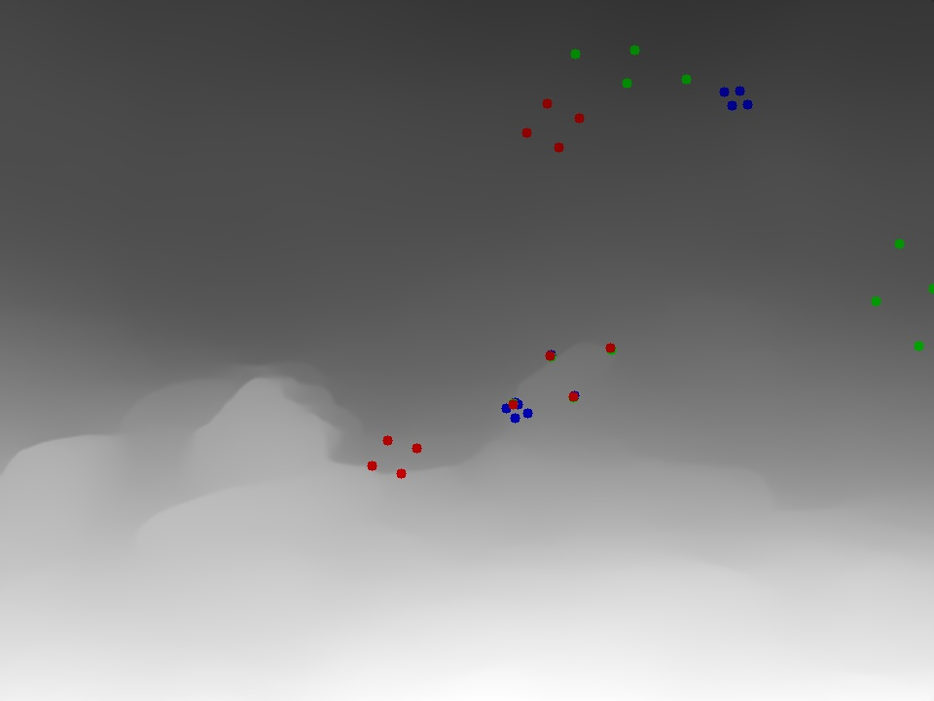
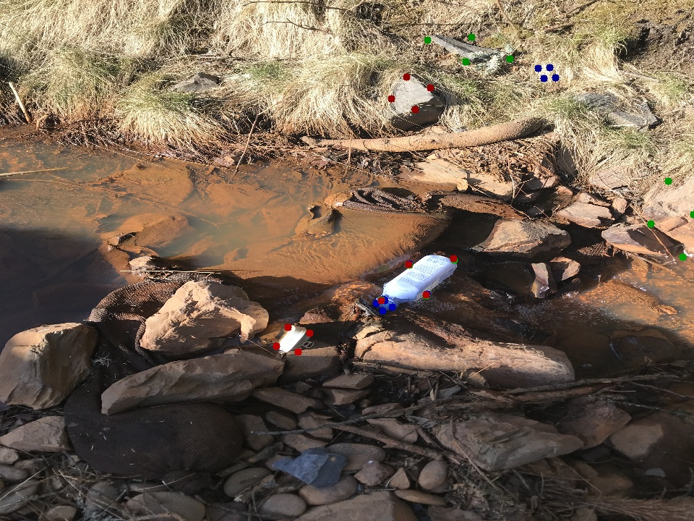
depth x-axis y-axis
b0 0.704 0.447 0.735
b0 0.696 0.432 0.739
b0 0.707 0.447 0.752
b0 0.684 0.432 0.722
g1 0.549 0.089 0.895
g1 0.537 0.053 0.906
g1 0.548 0.089 0.979
g1 0.542 0.053 0.822
r2 0.773 0.506 0.572
r2 0.705 0.471 0.553
r2 0.775 0.506 0.594
r2 0.706 0.471 0.531
b3 0.692 0.423 0.820
b3 0.648 0.379 0.786
b3 0.687 0.423 0.871
b3 0.642 0.379 0.735
g4 0.693 0.425 0.818
g4 0.649 0.381 0.787
g4 0.688 0.425 0.873
g4 0.643 0.381 0.732
depth x-axis y-axis
r5 0.570 0.157 0.798
r5 0.560 0.111 0.781
r5 0.570 0.157 0.827
r5 0.561 0.111 0.751
g6 0.559 0.113 1.044
g6 0.554 0.097 1.056
g6 0.560 0.113 1.067
g6 0.553 0.097 1.033
b7 0.601 0.308 1.331
b7 0.611 0.322 1.250
b7 0.603 0.308 1.283
b7 0.608 0.322 1.312
r8 0.693 0.424 0.818
r8 0.648 0.380 0.785
r8 0.687 0.424 0.871
r8 0.642 0.380 0.732

Slide 7

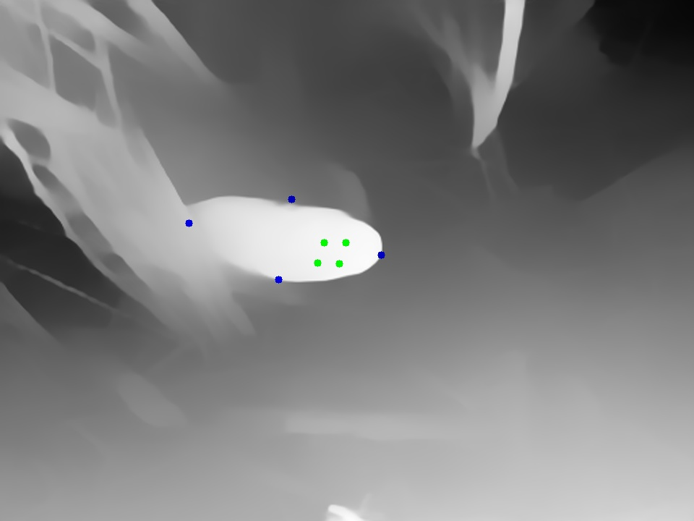
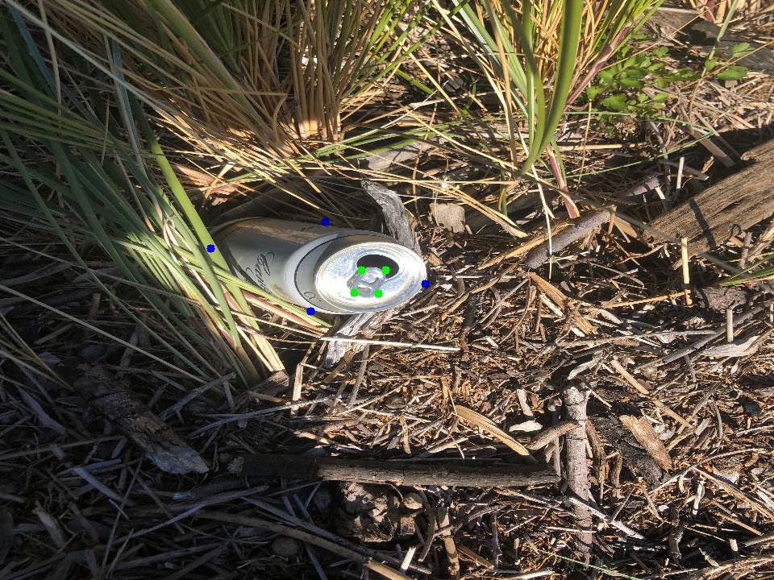
Software Pipeline
depth x-axis y-axis
b 0.878 0.402 0.535
b 0.729 0.286 0.560
b 0.710 0.402 0.733
b 0.770 0.286 0.362
g 0.982 0.379 0.652
g 0.979 0.349 0.623
g 0.984 0.379 0.664
g 0.978 0.349 0.611

